Slide 1


Colton Matthews
January 23, 2025

Slide 2

Outline
Executive Summary
Introduction
Methodology
Results
Conclusion
Appendix

Slide 3
Executive Summary
Before starting our research, the business question is asking how we can predict our rocket will be successful upon landing from different models. In analytic approach would be considered a classification problem because we want to predict if our rocket will return to Earth successfully from different models of our rockets.
We created machine learning models to determine which model has a very high accuracy to predict our successful landing. For the highest accuracy score, three models are equally scored Logistic Regression, Support Vector Machine, and K-nearest Neighbors with an accuracy score of 83% while the lowest accuracy score was 72% from the Decision Tree model.

Slide 4
Introduction
For this capstone, our fictional company, SpaceY, would like to compete with SpaceX to build inexpensive rockets (Falcon-9) and recover the rocket’s first stage back to Earth. Taking the role of a data scientist working for a new rocket company is to determine the price of each launch by gathering information about SpaceX and creating a dashboard for our team, and determine if SpaceX reuses the first-stage rocket, but will determine if the first-stage will land successfully.
Our business problem is to determine the price for each launch such that our analytic approach would be what is the price for each launch, such as models of the rocket that is more of a descriptive analysis. Another business problem is to determine if the first-stage rocket will land successfully, and an analytic approach would be how we can predict if the first-stage rocket will land successfully or fail to land; that would identify as a classification problem.

Slide 5

Section 1

Slide 6
Methodology
Executive Summary
Data collection methodology:
The data was collected by web scraping for both current and past launches from SpaceX to turn our data into a readable dataframe.
Perform data wrangling
Check and average the null values in ‘LandingPad’ column, count the values for Launch Site, types of Orbit, and types of Outcomes, and create a new column that shows the results of the first-stage outcome called ‘Class.’
Perform exploratory data analysis (EDA) using visualization and SQL
Perform interactive visual analytics using Folium and Plotly Dash
Perform predictive analysis using classification models
Transform, train and test the model, and evaluate the model by accuracy score.

Slide 7
Data Collection
Our data was collected by web scrapping from SpaceX’s table on their website.
To start our web scrapping process, we grab the URL and create an object by using the BeautifulSoup library to parse the HTML language, so we can find all of the ‘tables’ and ‘th’ tags to grab all the tables on the website.
We create lists of information for each column so we can convert all of the lists into a single dataframe.

Slide 8
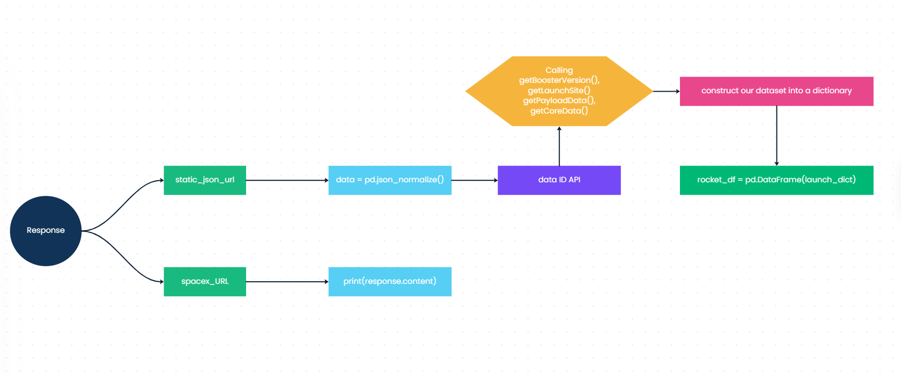
Data Collection – SpaceX API
Data Collection Notebook (GitHub Page)

Slide 9
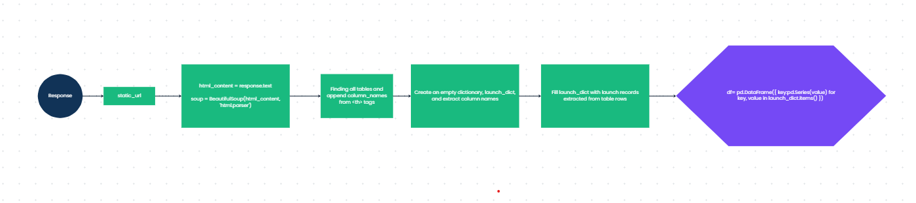
Data Collection - Scraping
Web Scrapping Notebook (GitHub Page)

Slide 10
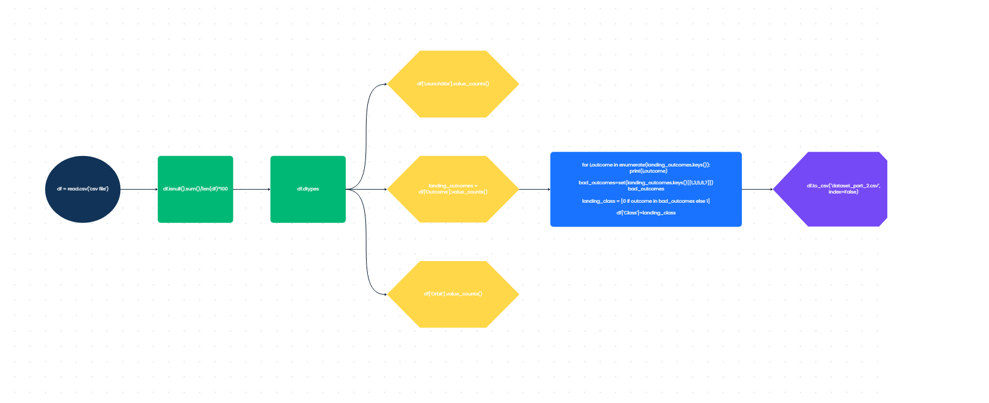
Data Wrangling
After the data collection process, we want to clean the data such that there are missing or null values so we can replace those missing values with an average. Checking the data types for each column and value count for ‘LaunchSite,’ ‘Orbit,’ and ‘Outcome.’ Lastly, create a new column called ‘Class’ that represents the classification variable for the outcome of each landing.
Data Wrangling Notebook (GitHub Page)

Slide 11
EDA with Data Visualization
There are five scatter point plots to show relationships and colored by ‘Class’ from our dataset.
PayloadMass vs. FlightNumber - by comparison, we see that the flight number increases and payload mass increases, the first stage is more likely to land successfully.
FlightNumber vs. LaunchSite - comparing launch site by flight number to see which has more successful landing.
PayloadMass vs. LaunchSite – by comparison, we see the more payload mass, the less likely to land successfully for each launch site.
FlightNumber vs. Orbit – comparing flight numbers to different types of orbit.
PayloadMass vs Orbit – comparing different payload mass to different types of orbit.
We made a bar chart to compare different orbit types with success rate.
Also plot a line chart to visualize the average success rate over the years (2010-2020).
Data Visualization EDA (GitHub Page)

Slide 12
EDA with SQL
Created a query to find distinct names of the ‘LaunchSite’ column.
Displaying 5 records where the launch sites contain a string ‘CCA’.
Display the total sum of payload mass carried by the boosters from NASA (CRS).
Average payload mass carried by booster version ‘F9 v1.1’.
Finding when the first successful landing outcome.
List of booster names that was successful in drone ship and payload mass between 4000 and 6000.
Listing total number of successful and failure mission outcomes.
Displaying the months in the year 2015 of the failure outcomes in drone ship.
Ranking the count of landing outcomes.
SQL Notebook (GitHub Page)

Slide 13
Build an Interactive Map with Folium
Adding two markers to the map to locate two different location in the United States.
Next, added circles to the map for marking the areas of each launch site locations.
After creating circles for each launch sites, we create a marker cluster to represent launch records including if the launch was successful or failure to land.
Adding mouse position feature to calculate the distance between coastline point and the launch site.
Drawing a PolyLine between a launch site to the selected coastline point.
Folium Notebook (GitHub Page)

Slide 14
Build a Dashboard with Plotly Dash
Created a pie chart to show a ratio of successful and failed landings for each launch site.
Add a dropdown feature for selecting all launch site, and launch site names.
Display a scatter point plot to compare payload mass and class, and colored by different boosters.
Add a slider to range payload mass.
Plotly Python File (GitHub Page)

Slide 15
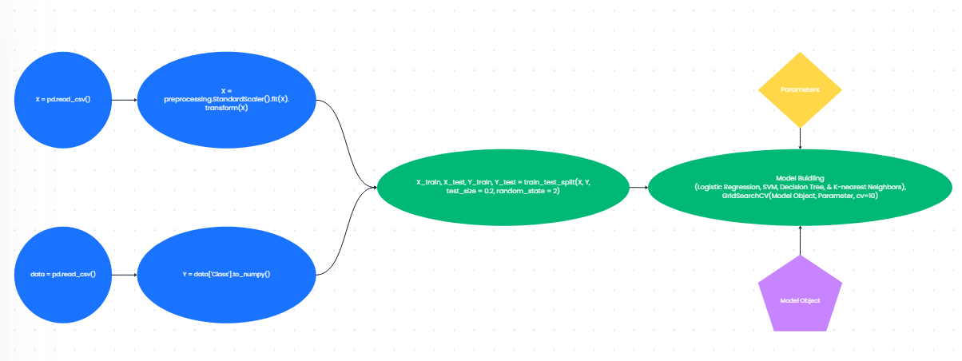
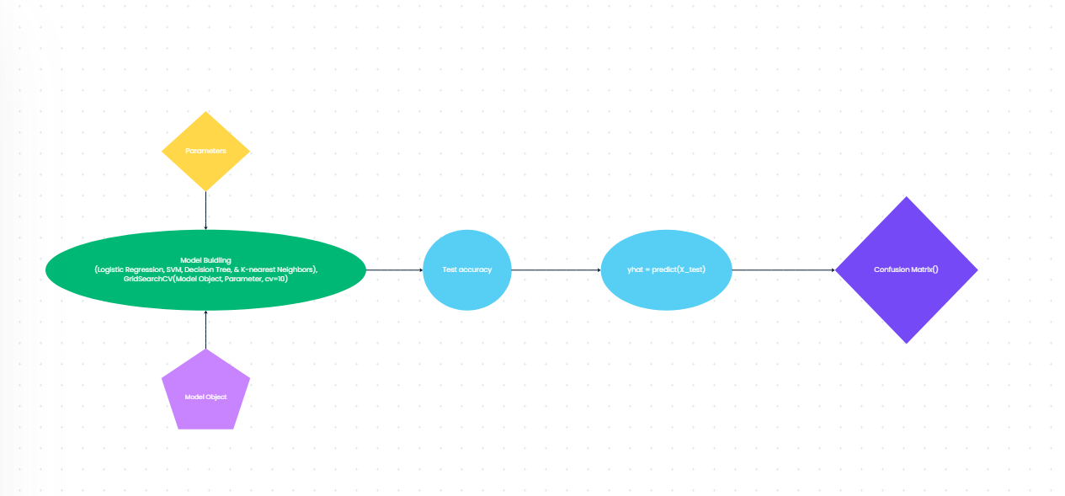
Predictive Analysis (Classification)
We created two different variables to represent X and Y, so we could train-test split the dataset before making our classification model.
We build the model for each ML technique (Logistic Regression, SVM, Decision Tree, and K-nearest Neighbor) with provided parameters to implement for GridSearchCV with cv = 10.
We evaluate the model by accuracy score and predict by using confusion matrix.
Predictive Analysis Notebook (GitHub Page)

Slide 16
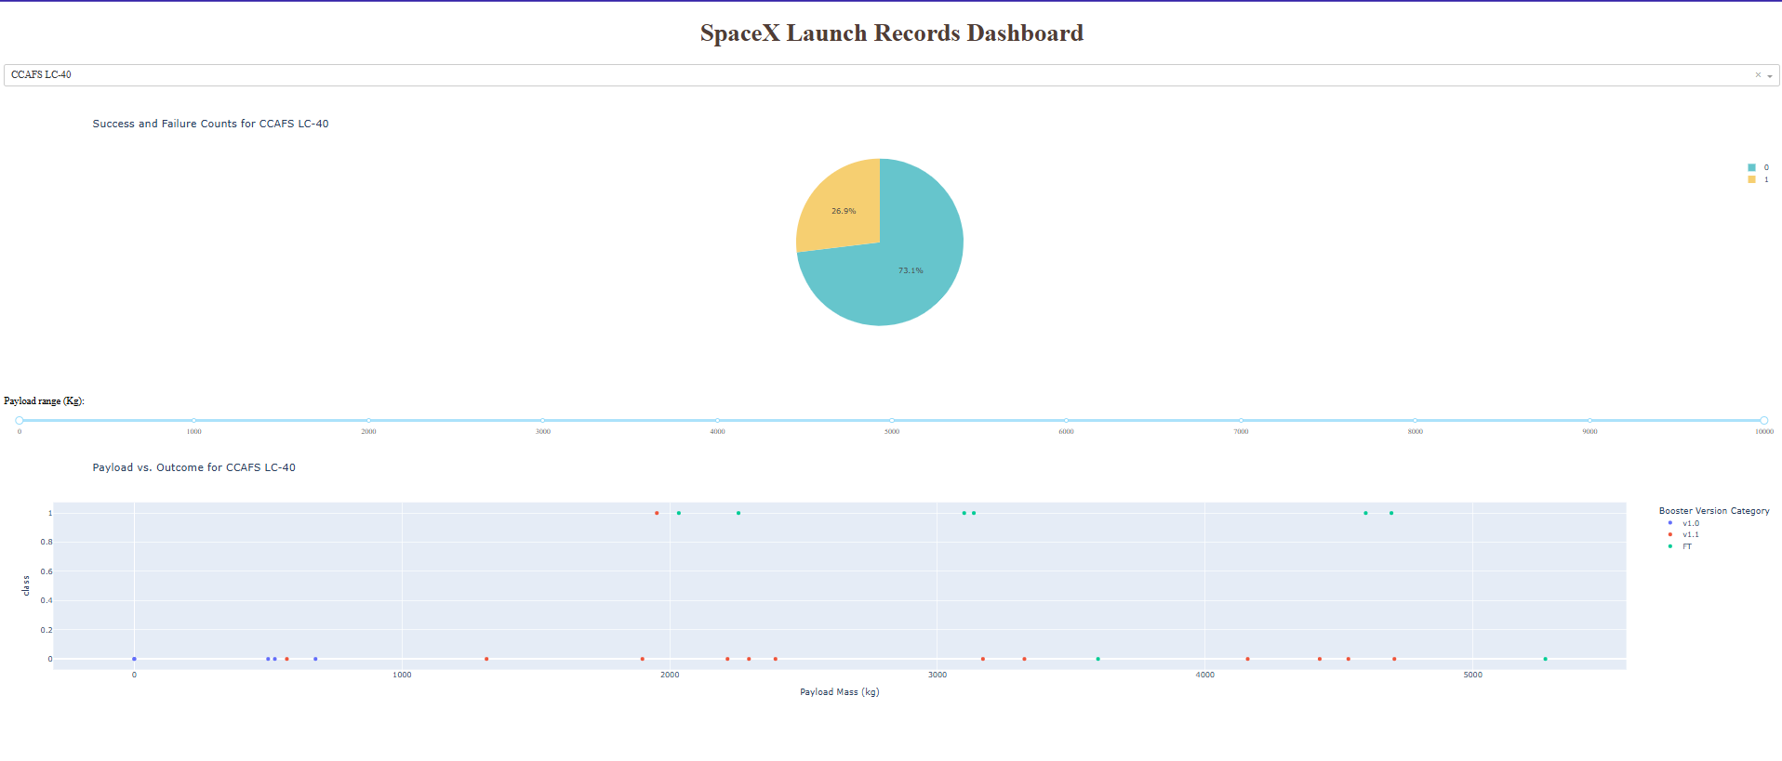
Results
Exploratory data analysis showed that certain payload mass and flight number increases are more likely to land successfully, and over the years of launching rockets had an increasing rate of landing first-stage rockets successfully.
Predictive analysis showed that logistic regression, k-nearest neighbor, and SVM had the same accuracy score of 83% in predicting the first-stage rocket to land successfully.

Slide 17

Section 2

Slide 18
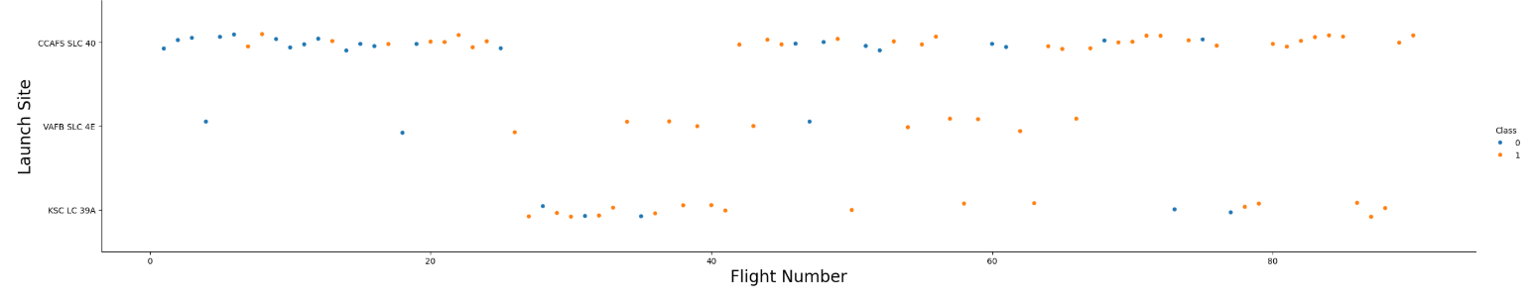
Flight Number vs. Launch Site
This plot shows the success rate of launches from different sites. Each point represents a launch, with orange points indicating successful launches and blue points indicating unsuccessful ones. The x-axis shows the flight number, while the y-axis shows the launch site. Patterns in the plot can help identify trends in the success rates of launches from each site.

Slide 19
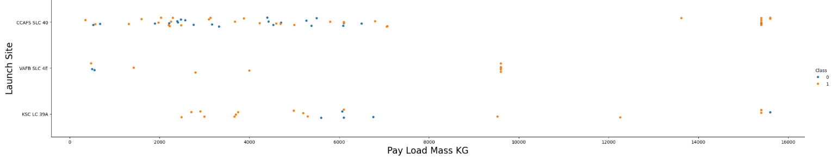
Payload vs. Launch Site
This scatter plot shows the relationship between the payload mass (in kilograms) and the launch sites for different classes of launches. The x-axis represents the payload mass, ranging from 0 to 16,000 kg, while the y-axis represents the launch sites: CCAFS SLC 40, VAFB SLC 4E, and KSC LC 39A. The points are color-coded, with blue representing unsuccessful launches (class 0) and orange representing successful launches (class 1). This plot helps visualize the distribution and success rates of launches based on payload mass and launch site.

Slide 20
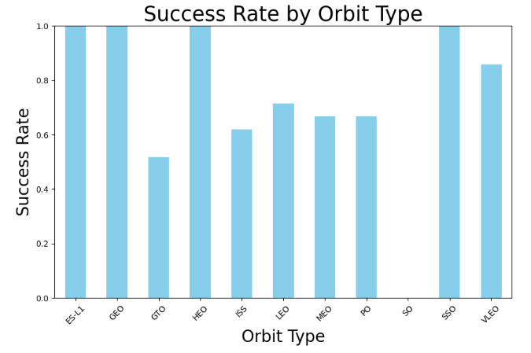
Success Rate vs. Orbit Type
This bar chart, titled "Success Rate by Orbit Type," shows the success rates for various orbit types. The y-axis represents the success rate, ranging from 0.0 to 1.0, where 1.0 indicates a 100% success rate. The x-axis lists different orbit types, such as ES-L1, GEO, GTO, HEO, ISS, LEO, MEO, PO, SO, SSO, and VLEO. The chart highlights that ES-L1, GEO, and SSO have the highest success rates at 1.0, while GTO has the lowest success rate, around 0.5. This visual comparison helps understand the reliability of missions to these orbits.

Slide 21
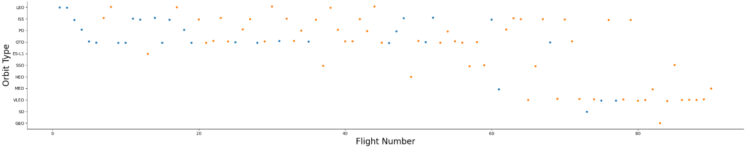
Flight Number vs. Orbit Type
This scatter plot shows the relationship between flight number and orbit type. The x-axis represents flight numbers from 0 to 90, while the y-axis lists various orbit types, such as LEO, ISS, GTO, and more. Each point indicates a specific flight number and its corresponding orbit type, with colors representing different categories or groups of data. This plot helps visualize the distribution of different orbit types across various flight numbers, revealing trends in space missions.

Slide 22
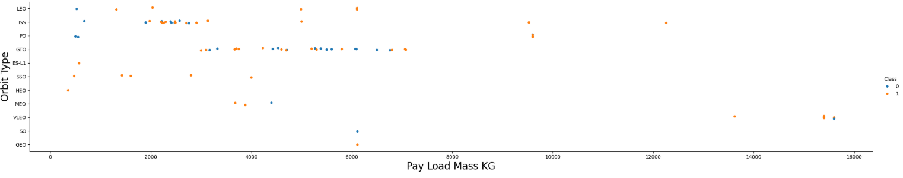
Payload vs. Orbit Type
This scatter plot shows the relationship between payload mass (in kilograms) and orbit type. The x-axis represents payload mass, ranging from 0 to 16000 kg, while the y-axis lists various orbit types like LEO, ISS, GTO, and more. Each point represents a payload, with blue points indicating one class and orange points indicating another. This plot helps visualize how different classes of payloads are distributed across various orbit types.

Slide 23
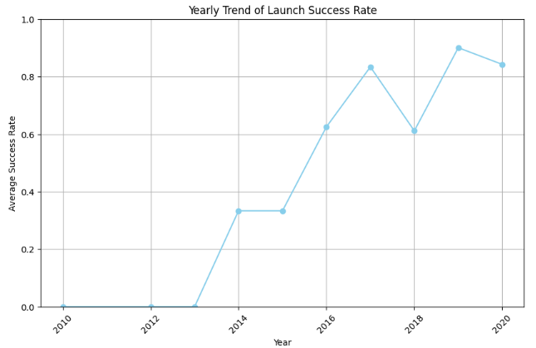
Launch Success Yearly Trend
This plot shows the yearly trend of launch success rates from 2010 to 2020. The x-axis represents the years, while the y-axis represents the average success rate, ranging from 0.0 to 1.0. The light blue line indicates changes in the success rate over the years, with notable increases starting from 2014 and peaks in 2018 and 2020. This trend highlights improvements in launch success rates over the decade.

Slide 24
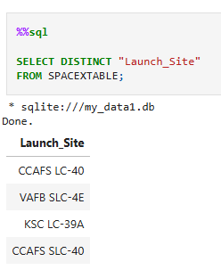
All Launch Site Names
This query retrieves a list of unique launch sites from the "SPACEXTABLE" database. By using the `SELECT DISTINCT` statement, it ensures each launch site is listed only once, helping to identify all the different locations from which launches have taken place.

Slide 25
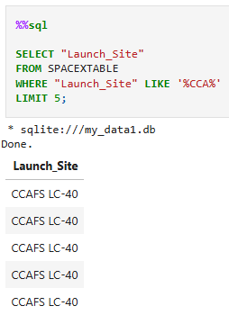
Launch Site Names Begin with 'CCA'
This SQL query retrieves the "Launch_Site" column from the "SPACEXTABLE" where the launch site name contains the substring "CCAF". The query limits the results to 5 entries. This is useful for filtering specific launch sites that match certain criteria. The output shows five rows with the "Launch_Site" value "CCAFS LC-40".

Slide 26
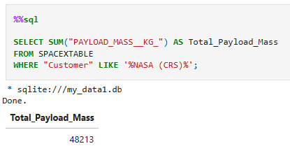
Total Payload Mass
This SQL query calculates the total payload mass for customers that include "NASA (CRS)" in their name. The result of the query shows that the total payload mass is 48,213 kg. This demonstrates how to aggregate data based on specific criteria, in this case, filtering customers with "NASA (CRS)" in their name and summing their payload masses.

Slide 27
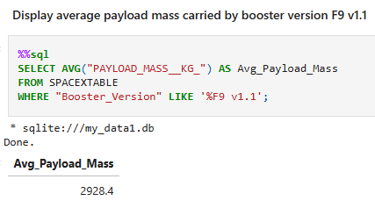
Average Payload Mass by F9 v1.1
This SQL query calculates the average payload mass carried by the booster version F9 v1.1. It selects the average value of the PAYLOAD_MASS__KG_ column from the SPACEXTABLE where the Booster_Version column matches the pattern %F9 v1.1%. The result is aliased as Avg_Payload_Mass. The result shows that the average payload mass for this booster version is 2928.4 kg. This helps understand the performance of the F9 v1.1 booster in terms of payload capacity.

Slide 28
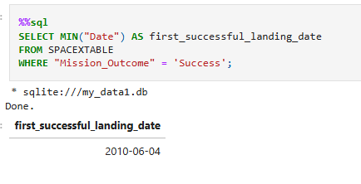
First Successful Ground Landing Date
This query is written in SQL and is used to find the earliest date of a successful landing from a table named SPACEXTABLE. It selects the minimum value from the Date column where the Mission_Outcome is 'Success', and labels the result as first_successful_landing_date. The query result shows that the first successful landing recorded in the table occurred on June 4, 2010. This provides specific information about the timeline of successful landings for the missions in the database.

Slide 29
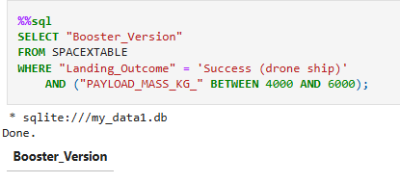
Successful Drone Ship Landing with Payload between 4000 and 6000
This SQL query retrieves the "Booster_Version" from the SPACEXTABLE
table where the landing outcome was 'Success (drone ship)' and the payload mass was between 4,000 and 6,000 kg. The query helps identify specific booster versions that successfully landed on a drone ship with payloads within this weight range.
The result is an empty table, which means no records match the specified criteria.

Slide 30
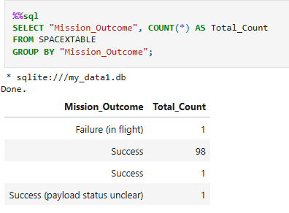
Total Number of Successful and Failure Mission Outcomes
This SQL query counts the number of occurrences of each unique "Mission_Outcome" in the SPACEXTABLE table. It groups the results by "Mission_Outcome" and labels the count as "Total_Count". The output shows different mission outcomes and their respective counts, such as 98 successful missions, 1 failure in flight, 1 success with an unclear payload status, and an additional entry for success.
And the output:
Failure (in flight): 1
Success: 98
Success: 1
Success (payload status unclear): 1
This helps to summarize the outcomes of all missions in the table.

Slide 31
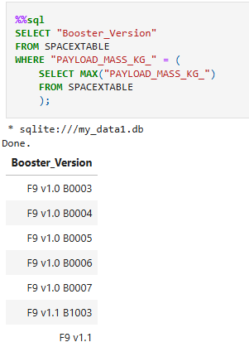
Boosters Carried Maximum Payload
This SQL query finds the booster versions associated with the maximum payload mass in the SPACEXTABLE table. It does this by first selecting the maximum value of PAYLOAD_MASS_KG_ and then comparing each record's payload mass to that maximum value. The output lists the booster versions that carried the heaviest payloads.

Slide 32
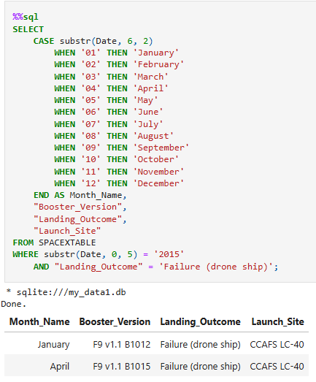
2015 Launch Records
This SQL query retrieves the month name, booster version, landing outcome, and launch site for launches that happened in 2015 and had a landing outcome of "Failure (drone ship)." It converts the month part of the date into the corresponding month name using a CASE statement. The result shows two records with failures in January and April 2015.

Slide 33
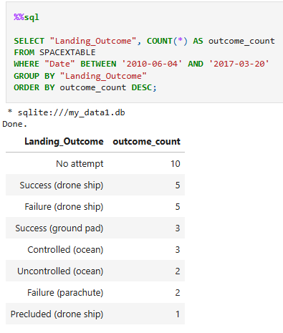
Rank Landing Outcomes Between 2010-06-04 and 2017-03-20
This SQL query counts the occurrences of each "Landing_Outcome" in the SPACEXTABLE for dates between '2010-06-04' and '2017-03-20'. It groups the results by "Landing_Outcome" and orders them by the count in descending order. The output shows the frequency of different landing outcomes within that period, helping to analyze the success and failure rates of SpaceX landing attempts. This table provides insights into the distribution and frequency of different landing outcomes for SpaceX launches during the specified date range.

Slide 34

Section 3

Slide 35
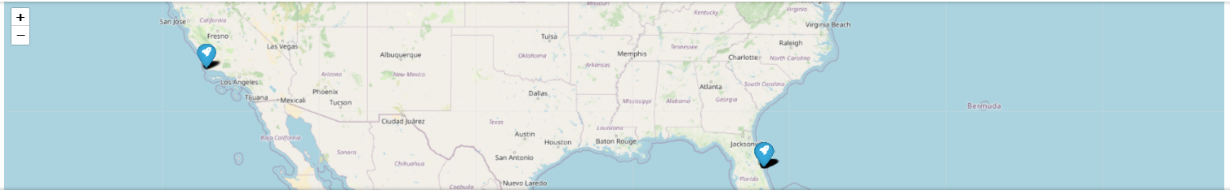
Two Pins of Launch Locations
This map shows the two markers that were added to the map of the locations where the rocket was launched in two different locations in the United States.

Slide 36
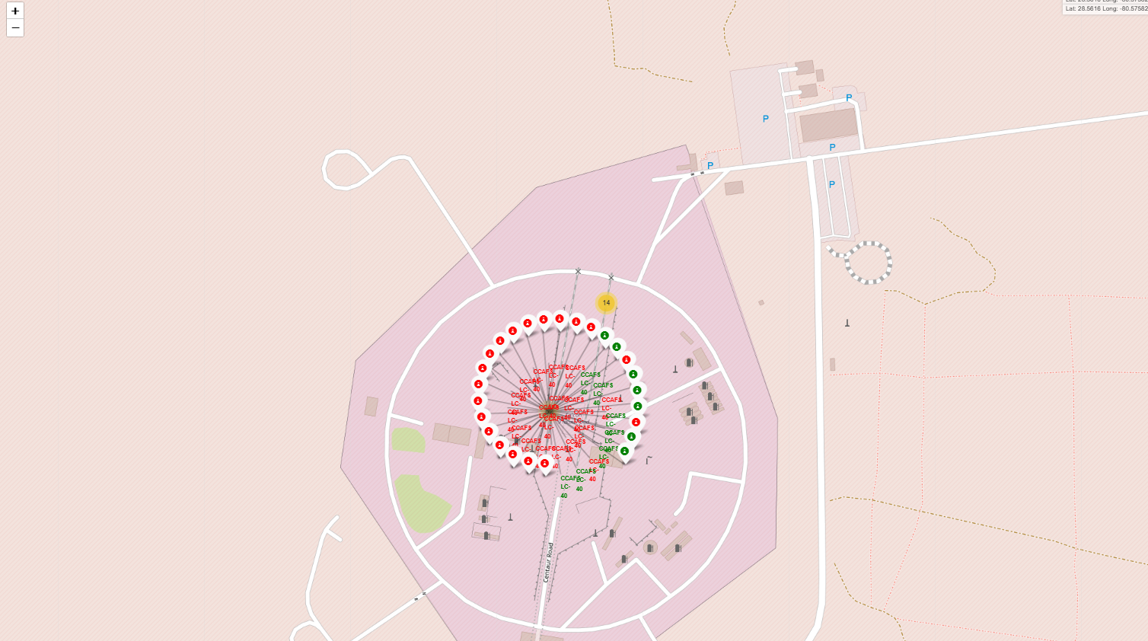
Launch Cluster Outcomes
This map shows pins of launch records in one location with colored coded outcomes of green indicating successful landing and red indicating unsuccessful landing.

Slide 37
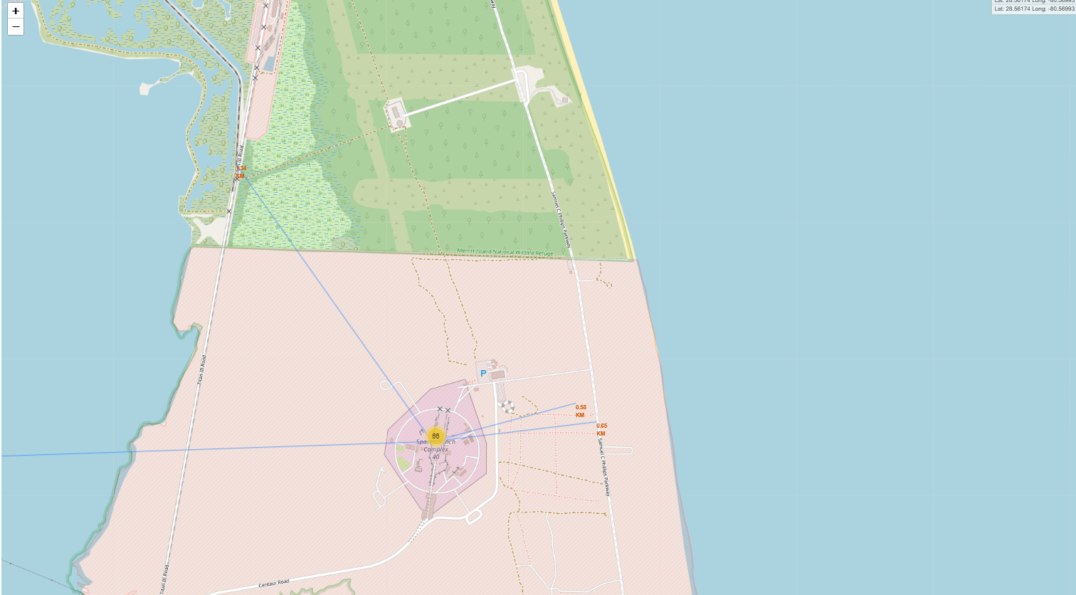
Distance from Launch Site
This map shows a few lines to show the distance between the launch site to roads, railroads, city, etc.

Slide 38

Section 4

Slide 39
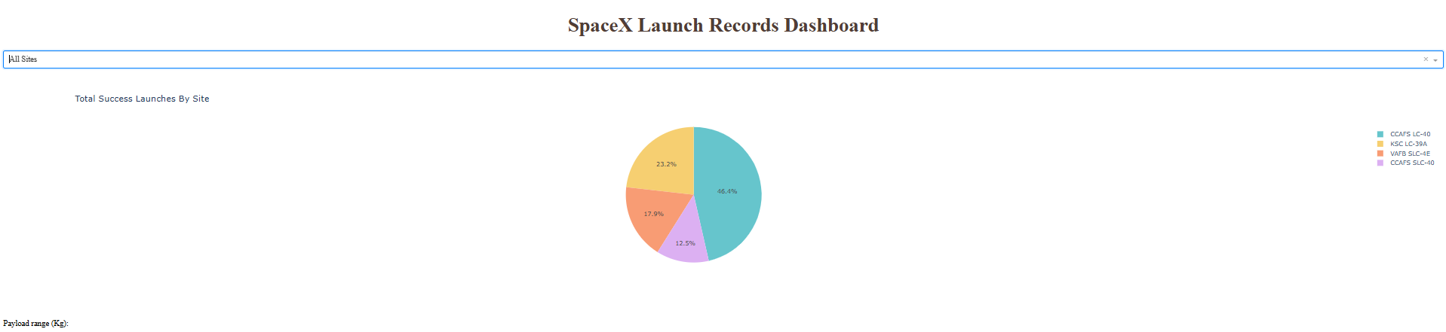
All Launch Site Ratio
This pie chart shows the total success rate for all launch sites. This pie chart helps to compare different launch sites by their success rate.

Slide 40
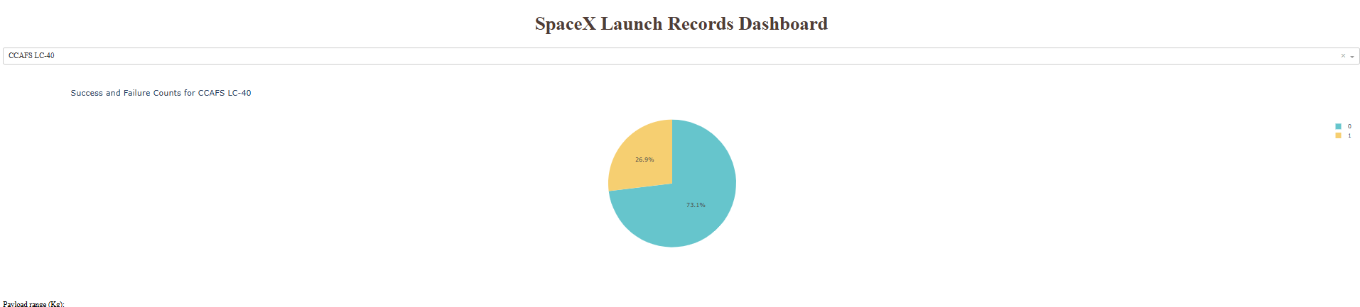
Most Success Rate
By comparing each launch site’s success rate in the ‘All Site’ pie chart, the highest success rate is CCAFS LC-40 at 73.1%.

Slide 41
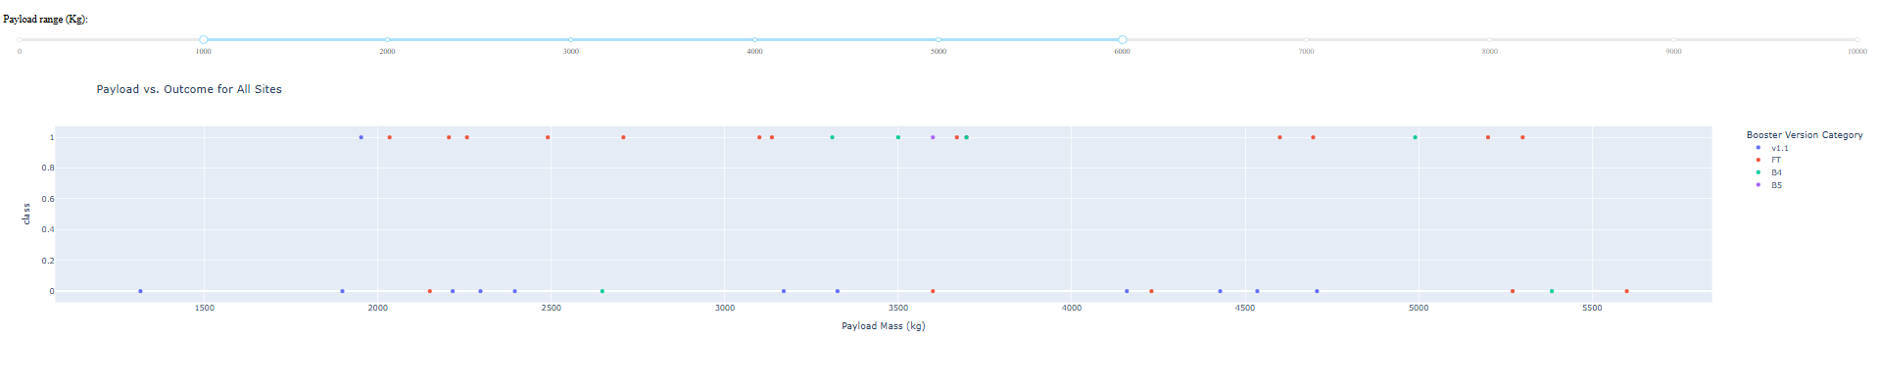
Scatter Point Plot (Payload Mass vs Class)
This scatter point plot shows all launch sites where each launch has a different payload mass indicating if each launch is successful or unsuccessful landing.

Slide 42

Section 5

Slide 43
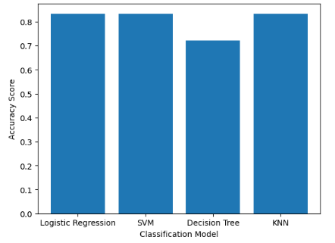
Classification Accuracy
The bar chart shows the accuracy score for each classification model, but it shows that the three models have the same accuracy score of 83.34%, while the lowest accuracy score is 72.22% for the decision tree model. The best models for this research would be logistic regression, support machine vector, and k-nearest neighbors.

Slide 44
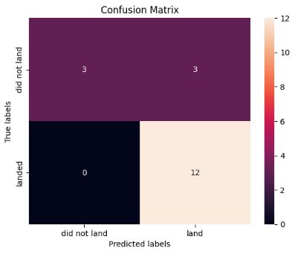
Confusion Matrix
This confusion matrix shows the predicted labels vs. the true labels from the test set of our data, but the three models (logistic regression, support vector machine, and k-nearest neighbor) have the same accuracy score and confusion matrix.

Slide 45
Conclusions
The most successful rate for landing a first-stage rocket is CCAFS LC-40 compared to the rest of the launch sites.
The success rate has been improving over the years since 2010.
In predictive analysis, the best model to predict a successful landing is the logistic regression, SVM, and k-nearest neighbor.

Slide 46
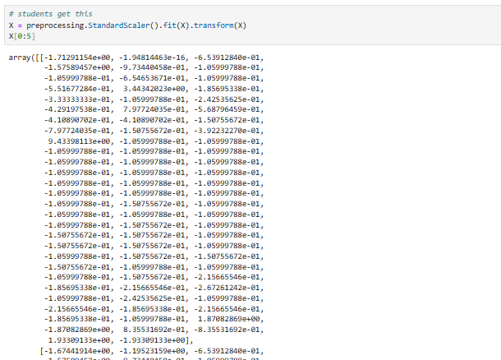
Appendix
The most common issue for the predictive analysis when trying to compute the SVM model (causing the cell to run infinitely) is making sure that the ‘X’ variable is reassigned (instead of assigning preprocessing to ‘transform’) to ‘X.’

Slide 47


